Slide 1
Fortran application II
IFFT

Slide 2
FFT and IFFT
Call fft(xr,xi,n,nu)
N=2^nu
After FFT the amplitude need to multiply dt
Sampling rate = 1./(dt)
  Dt sampling interval
Nyquist Frequency = 1./(2.*dt)

Slide 3
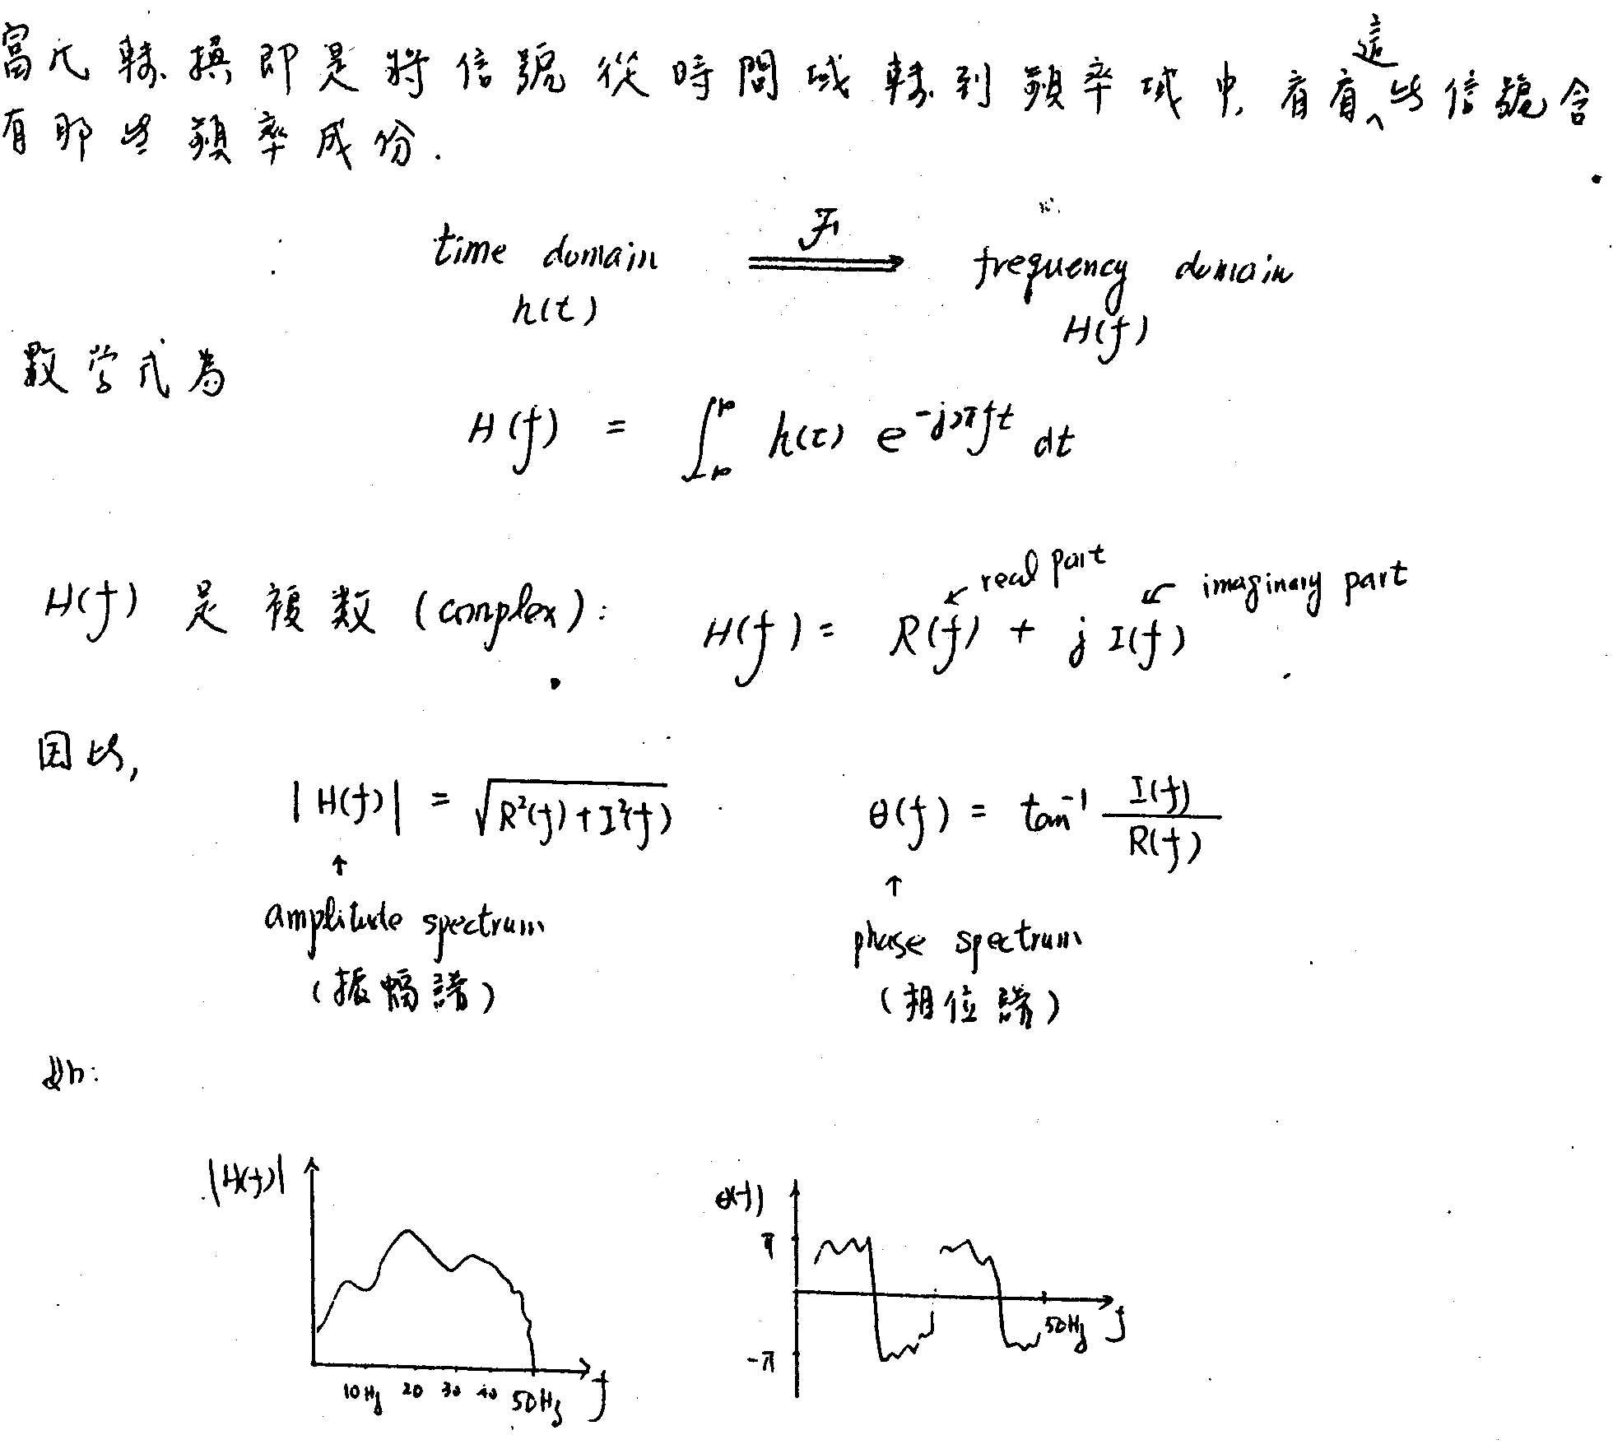

Slide 4
After FFT
Frequency Interval = 1./(N*dt)
Frequency 0 hz → Baseline
Repeat half frequency domain data

Slide 5
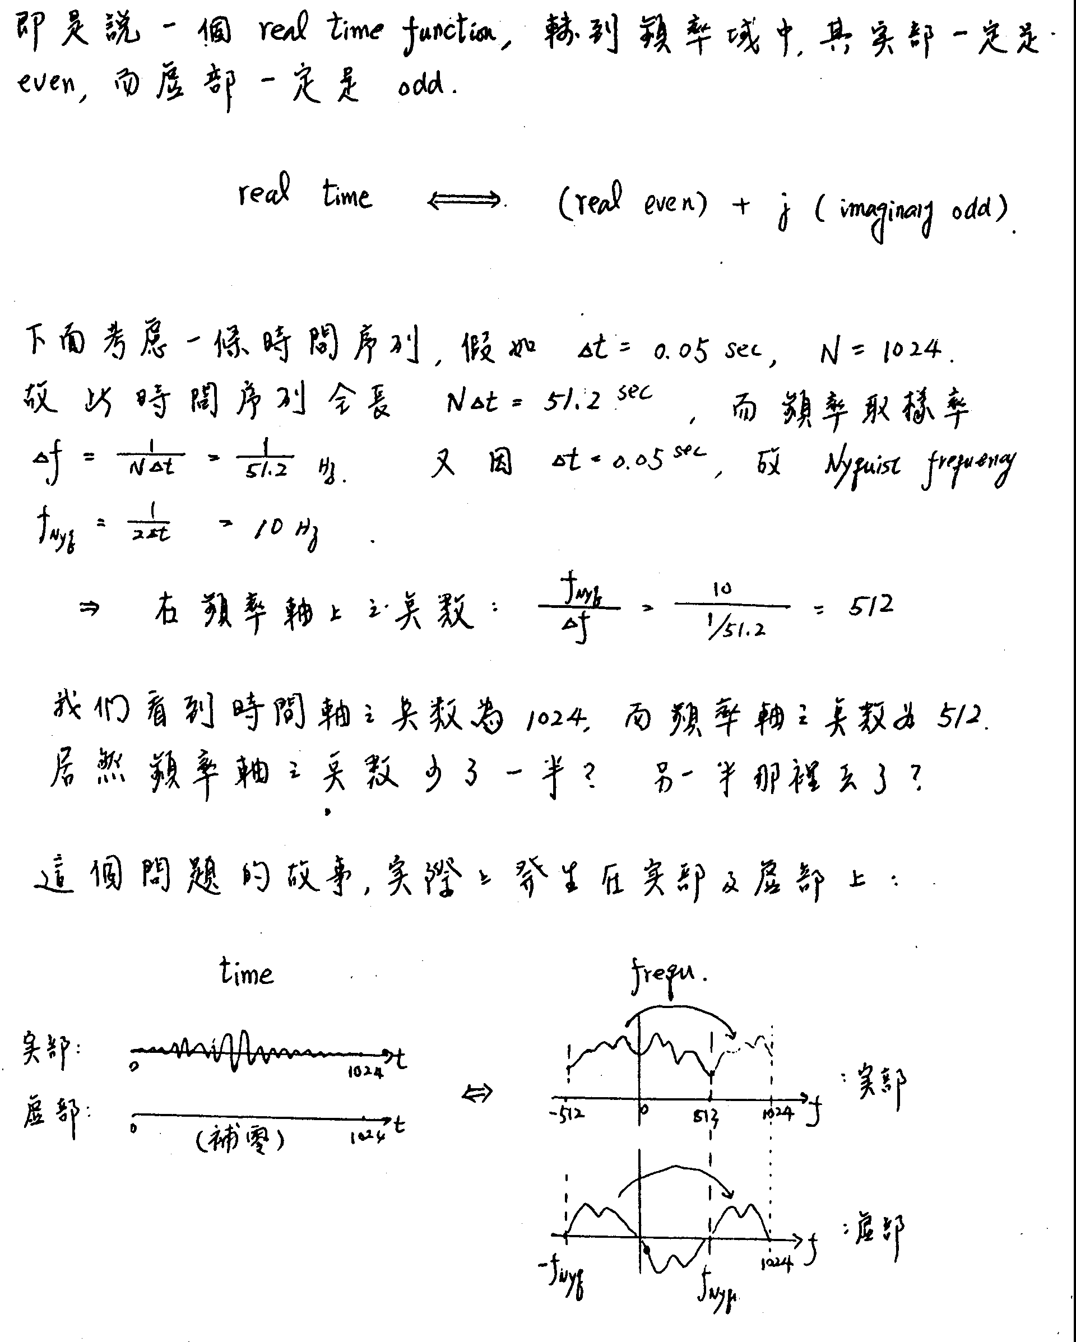

Slide 6
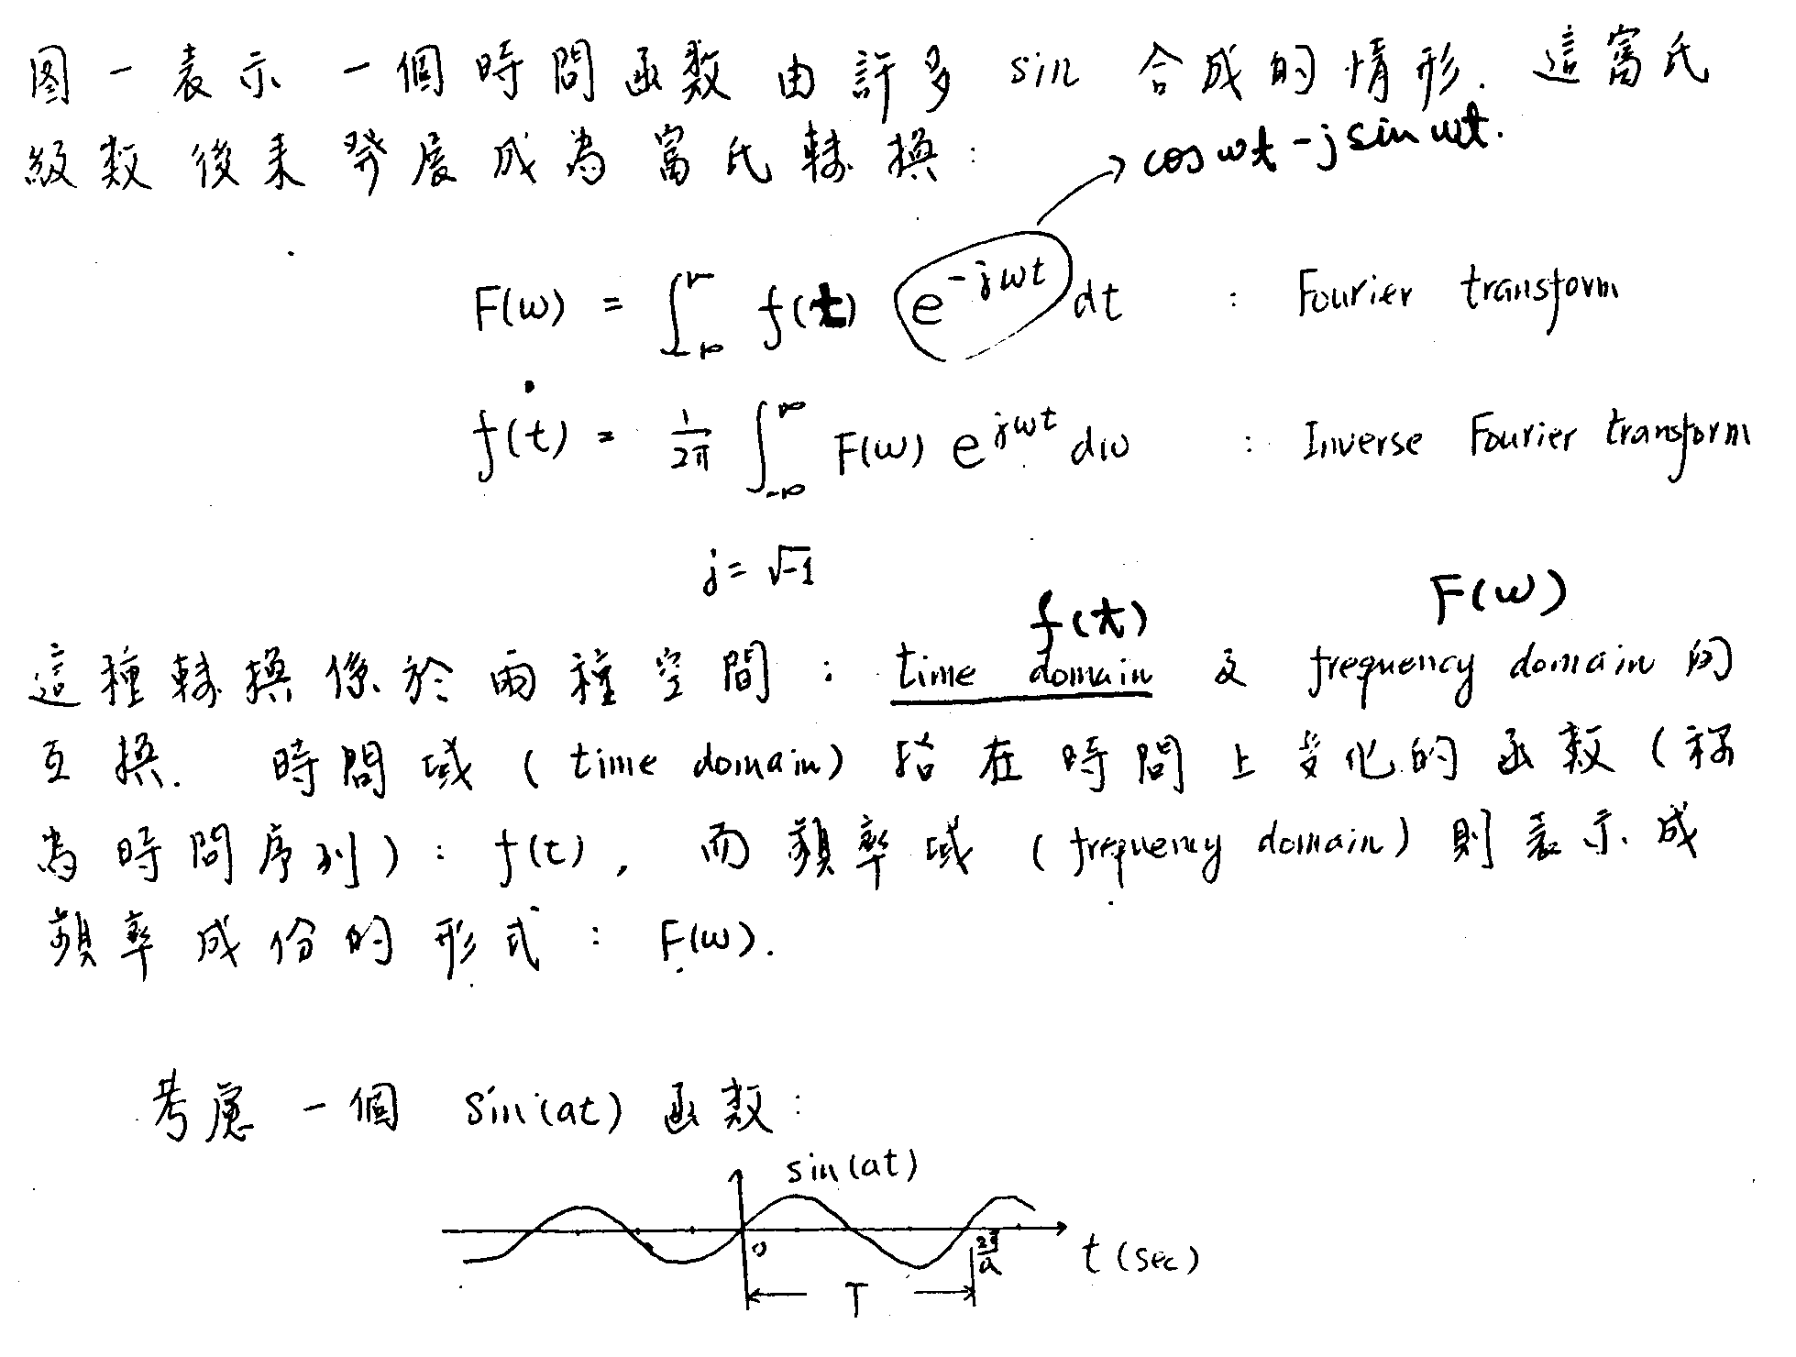

Slide 7
IFFT
Call FFT(Xr,Xi,N,Nu) →
  Xr=Xr/real(n)
  Xi=-Xi/real(n)
Call FFT(Xr,Xi,N,Nu) →Ifft
Devide N is due to (FFT *dt and IFFT *df) df is 1/(N*dt)

Slide 8
Homework I
請將seismicdata.bin (binary file)地震波形讀出並使用FFT繪出頻譜，將0.5-3Hz訊號保留，其餘訊號設成0.0，再經IFFT轉成時間域繪出圖。
Using seismicdata.bin waveform to do FFT and keep 0.5 to 3 Hz signals and do IFFT to time domain. Please the filtered waveform.

Slide 10
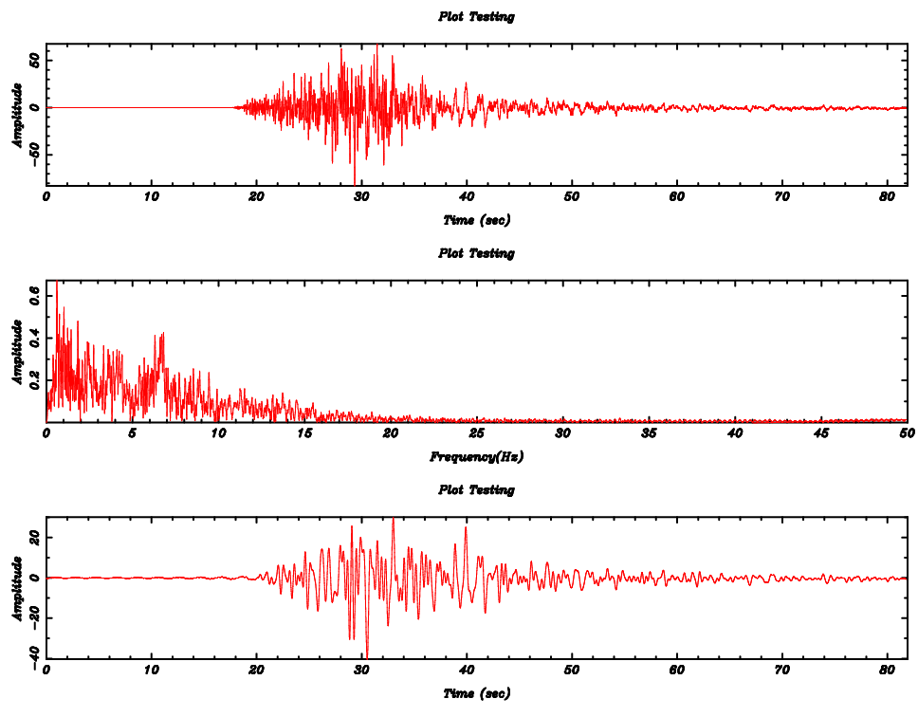

Slide 11
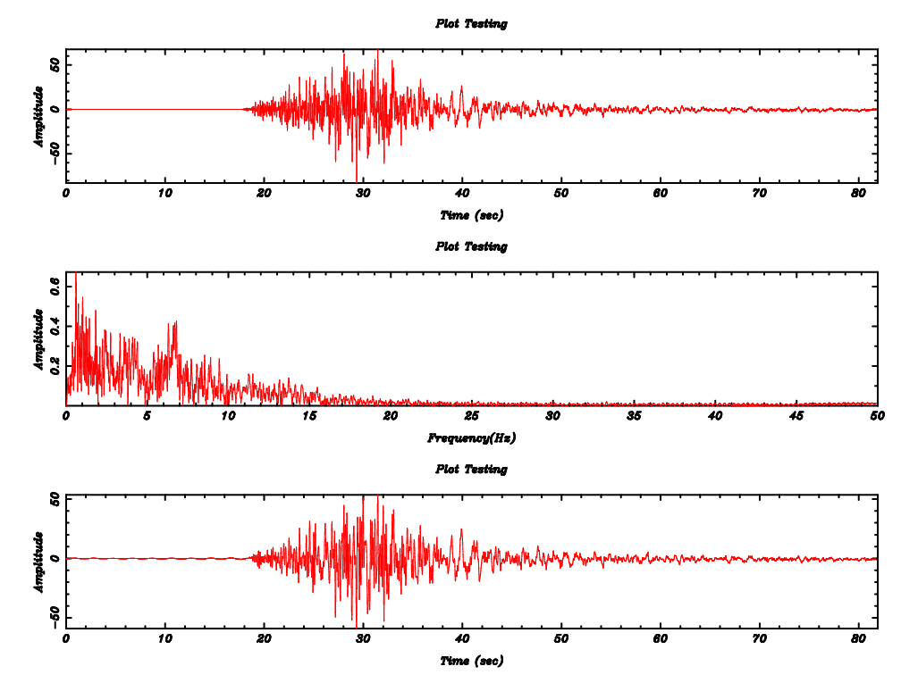
0.5-8Hz

Slide 12
Fortran application
Filter

Slide 13
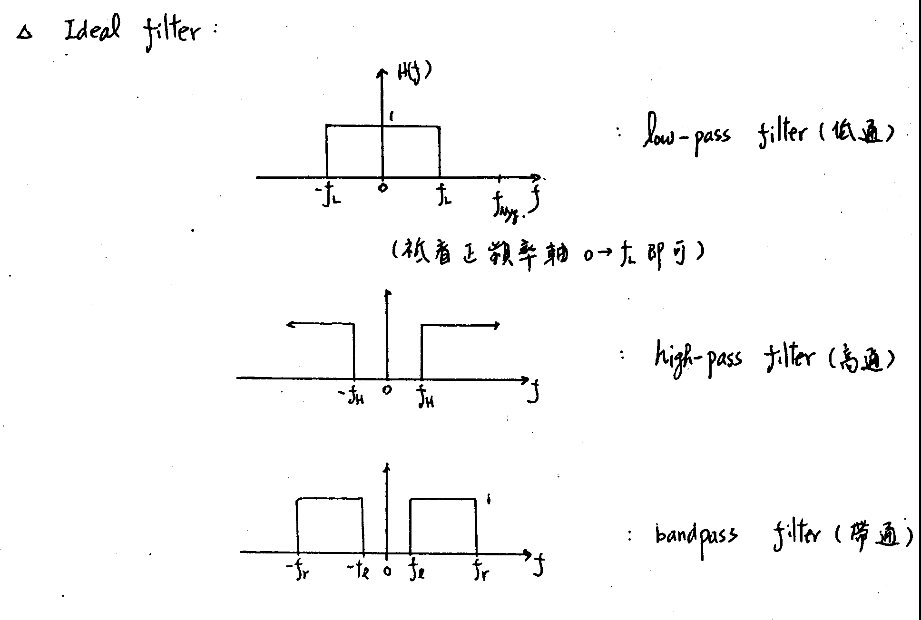

Slide 15
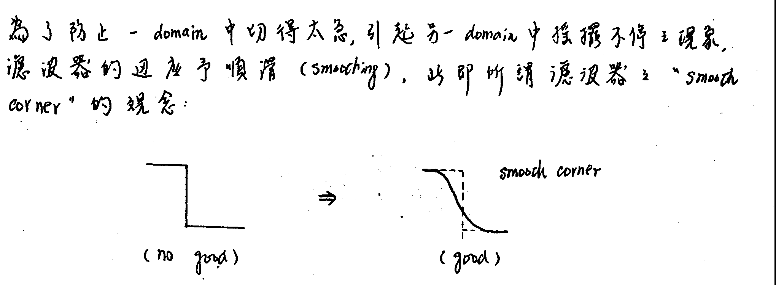

Slide 16
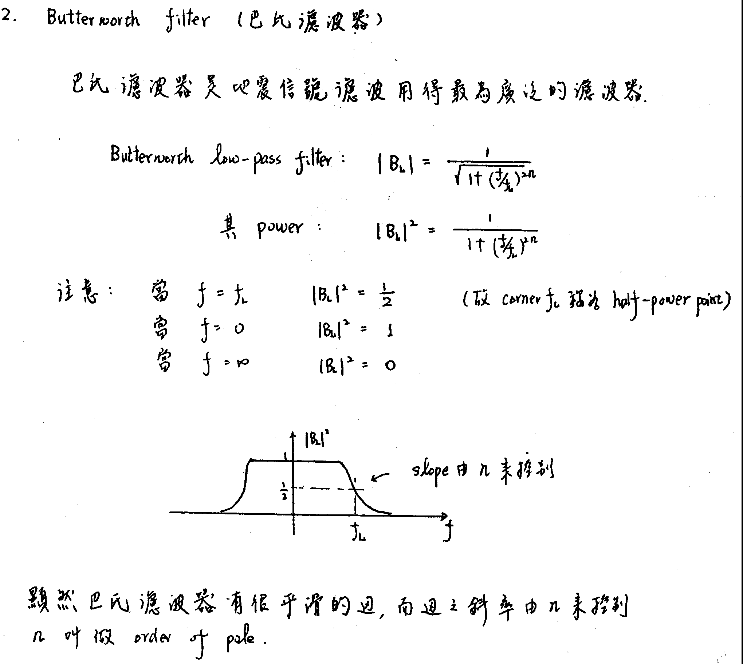

Slide 17
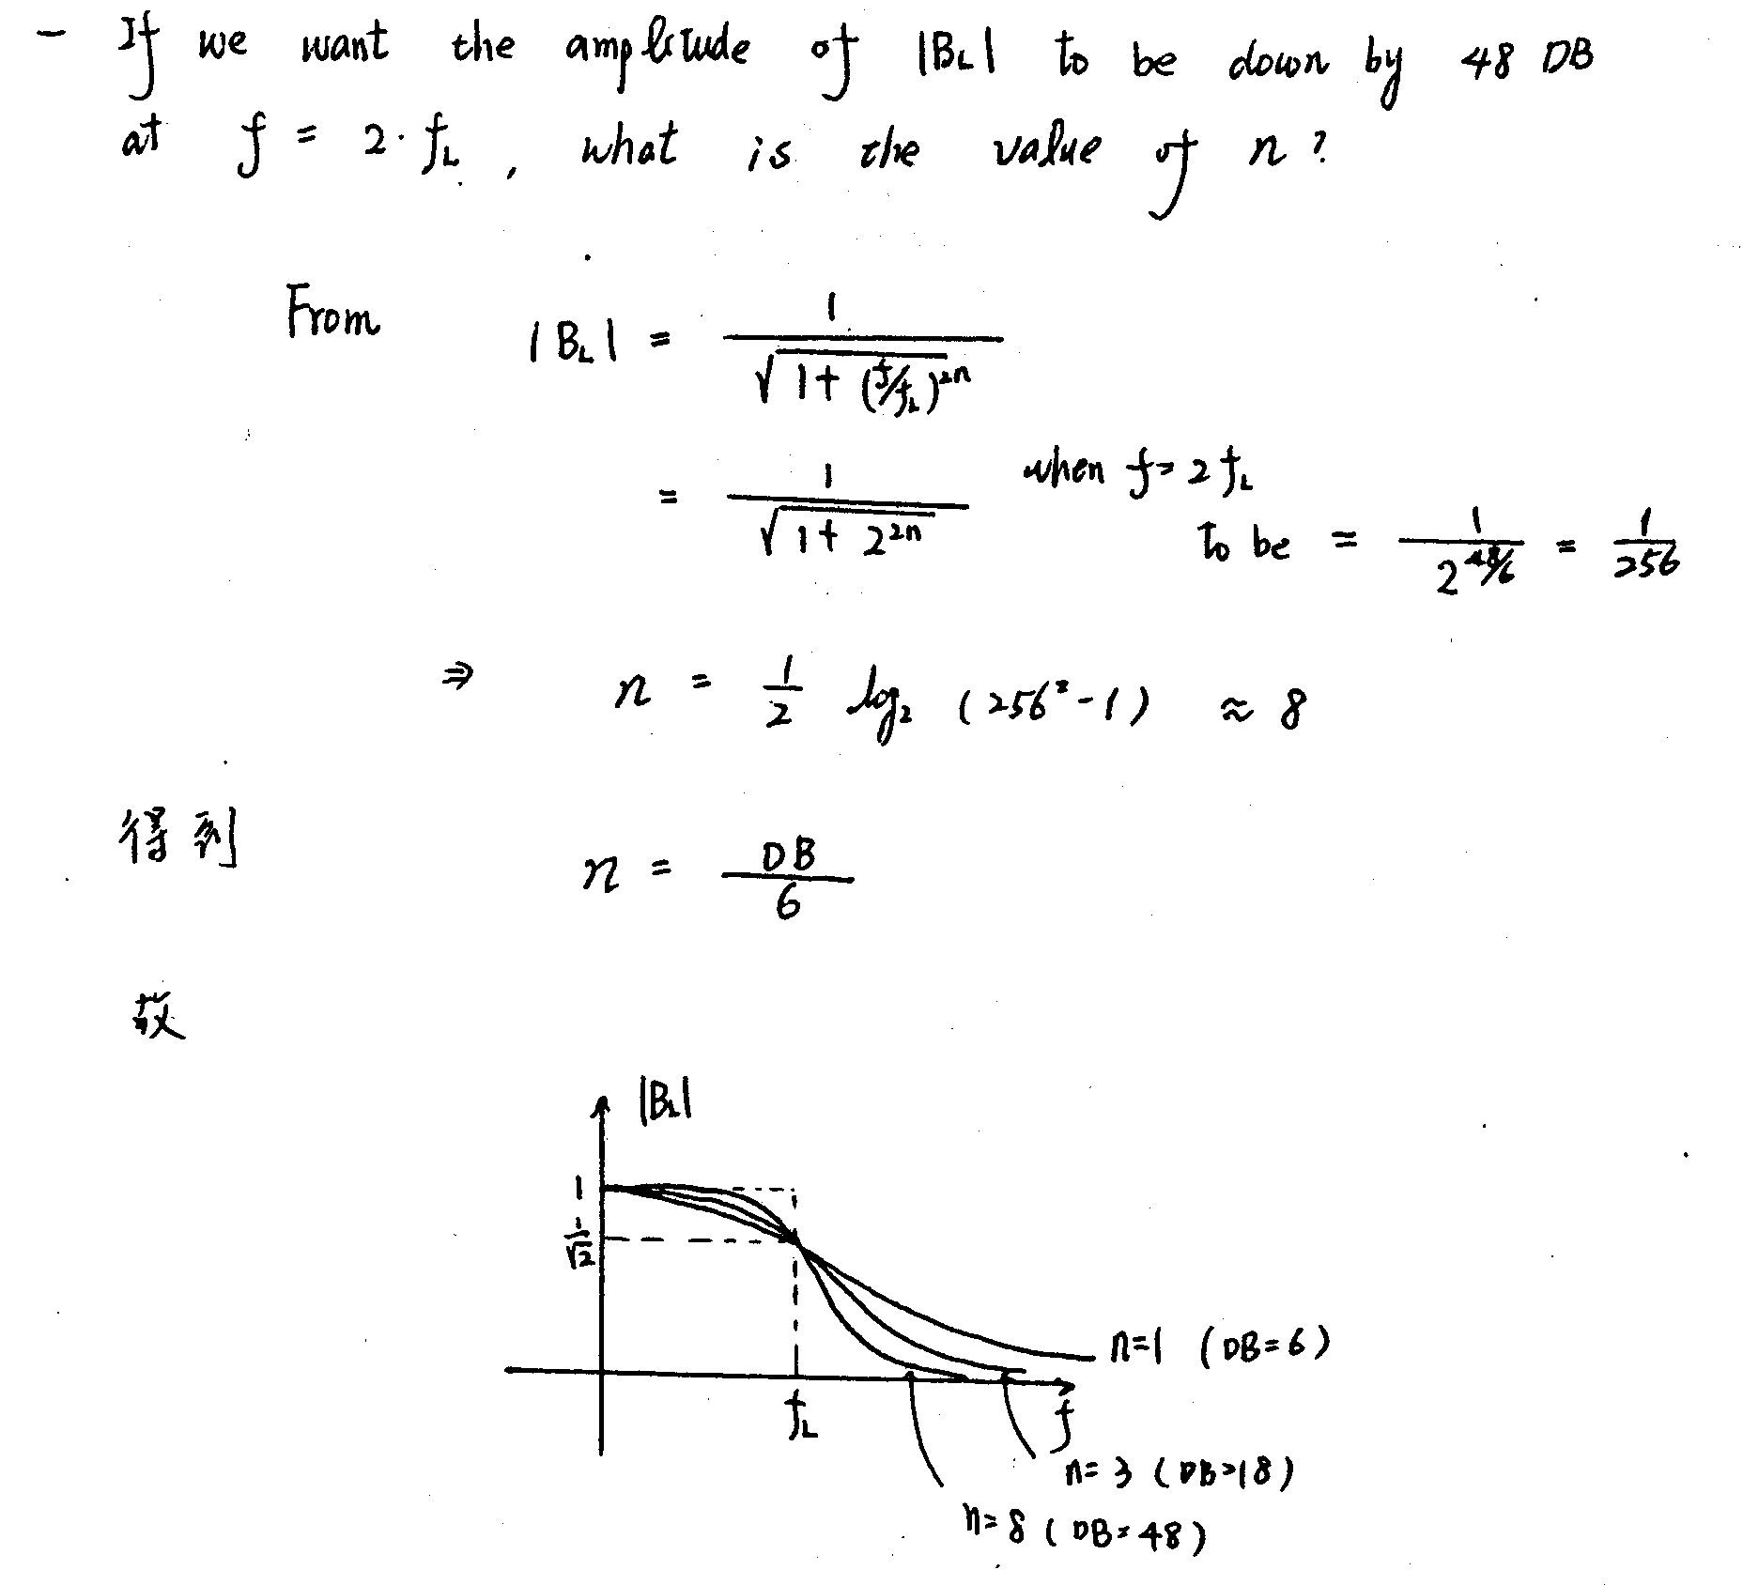

Slide 18
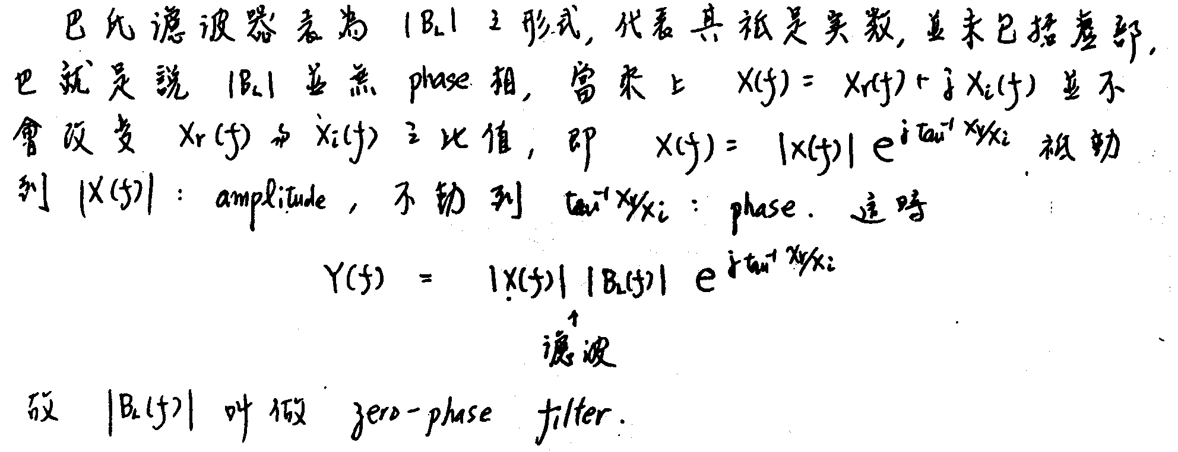

Slide 19
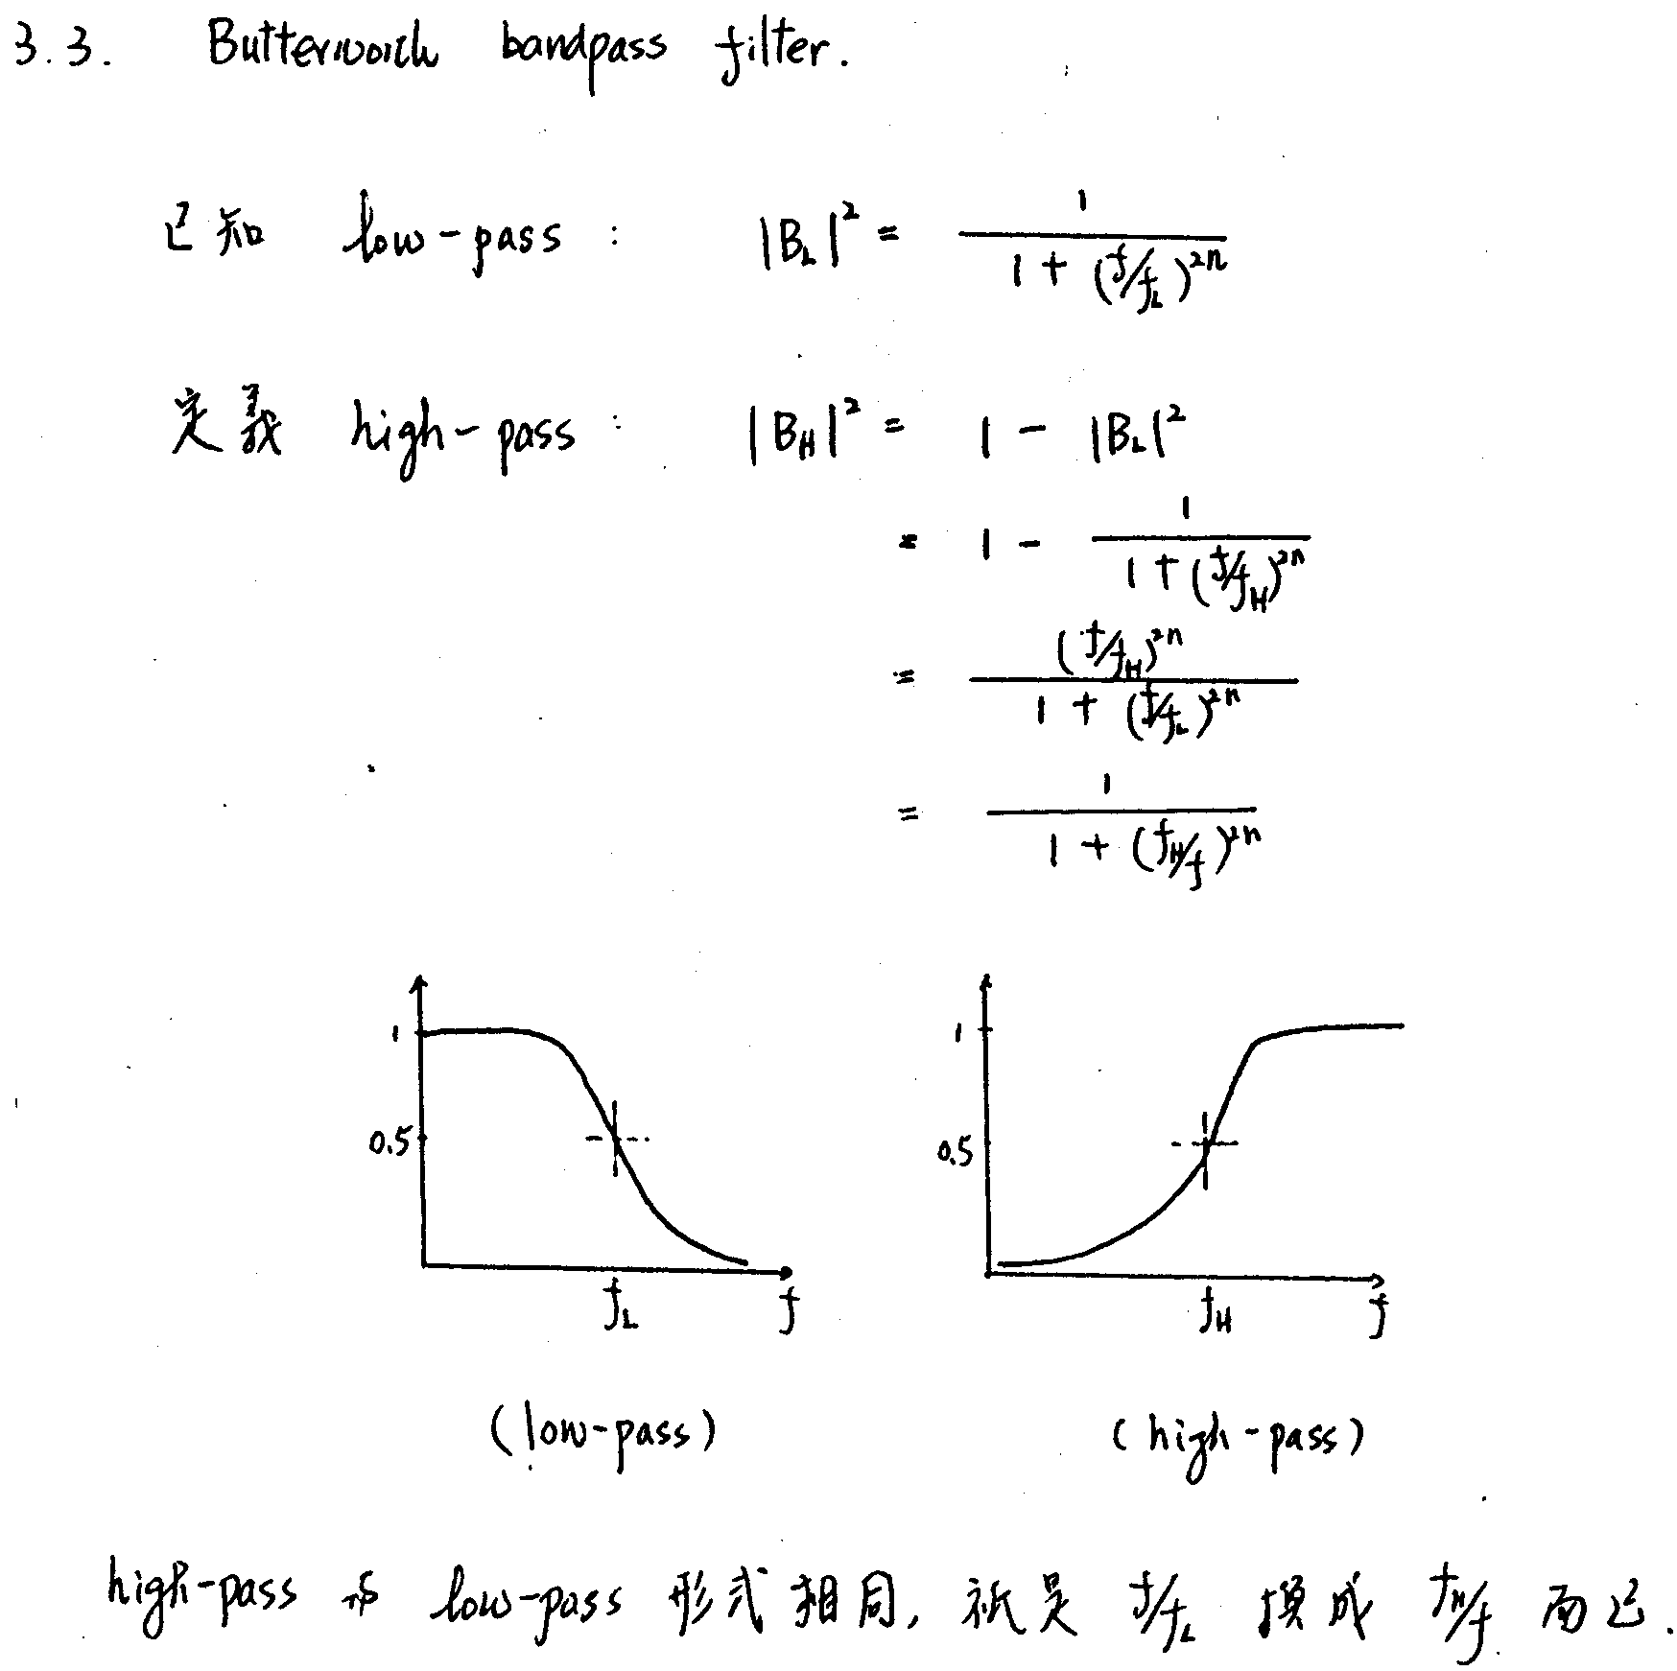

Slide 20
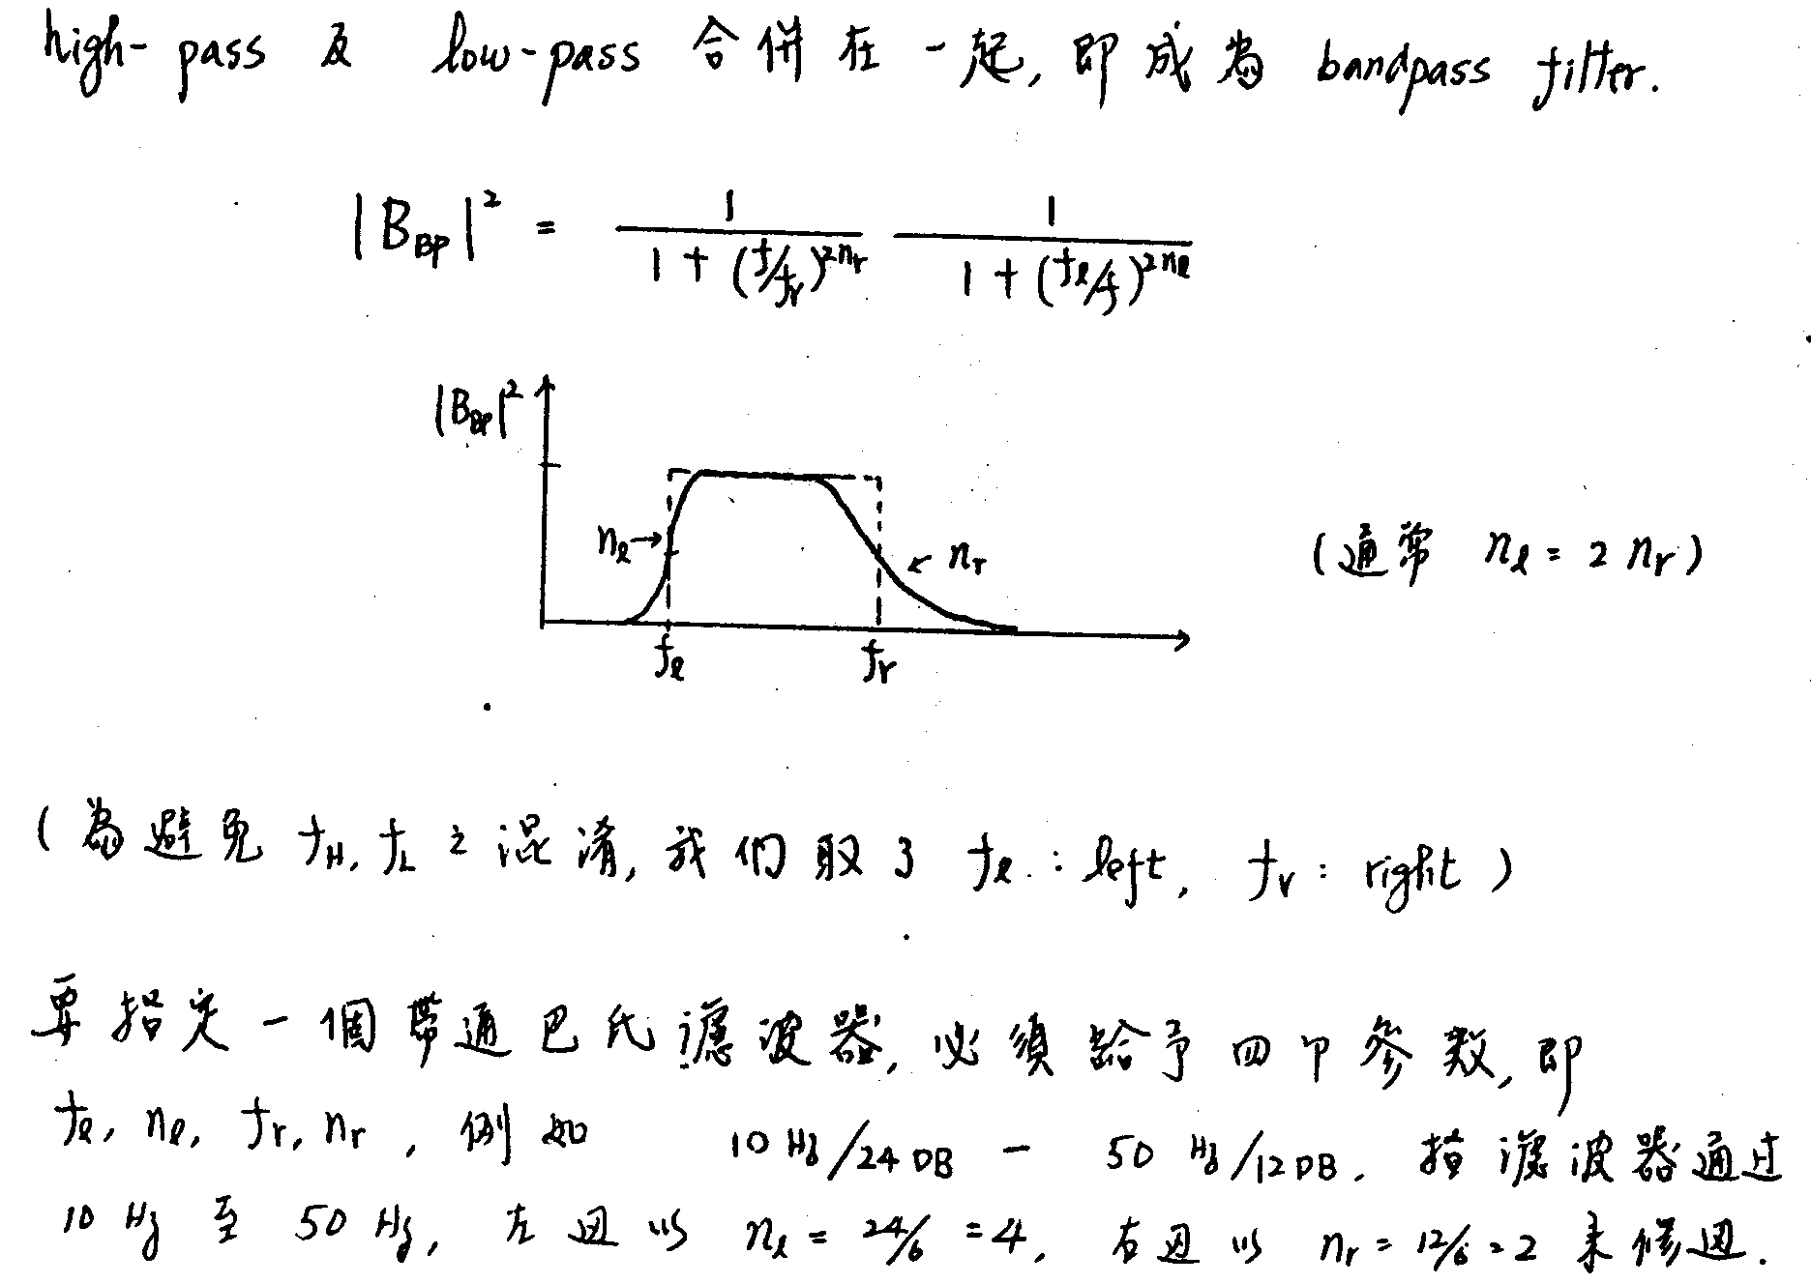

Slide 21
Homework II
Read the waveform from seismicdata.bin and using recursive filter to bandpass filter from 0.5 to 3Hz using 4 order of pole. Ploting the filtered waveform.
call IIRFILT( DATA1, NP, 'BUTTER ',4,'HP ', lowcorner, highcorner, DT, 2 )

